Slide 1
A Population Ignored: An Interview with Craig Johnson
Chandreyee Johnson

Slide 2
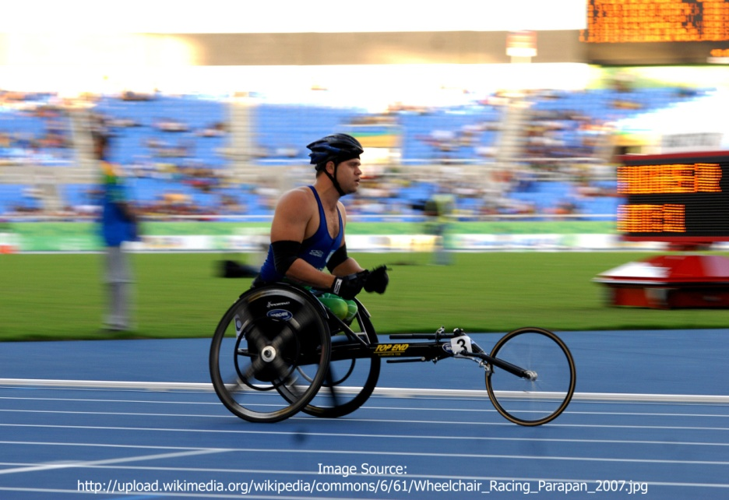
Being Different
How do you refer to yourself?
How do people refer to you?
“Craig”
  To general people, I don’t make any notation of difference.
  If I’m seeking help, I’m disabled or handicapped.
Wheelchair Expectations
  Assumptions that how I look determines how they expect me to behave.
Notes:
Despite having a strong history in dealing with people who are disabled, before I officially started my interview, I found myself uncomfortable using the terms “handicapped,” “disabled,” and “differently-abled” in reference to my interviewee. I decided I would ask my interviewee, Craig Johnson, how he preferred to be referred to as. I was taken back and we both laughed at his response, “Craig.” After clarifying what I meant, he went on to explain that if it’s some person he interacts with or even doesn’t know, he doesn’t make any physically indicating references to himself. He stated that he felt that it was “none of their concern”, and I agree with him. Both of us also agreed that being called, “differently-abled” sounded worse than just saying “disabled” or “handicapped.” After these clarifications, he went onto explain that when it comes to dealing with the general populous, he preferred to remain as unidentifiable as possible when it came to his disability. He also stated that he felt that the only time it was necessary for other individuals to know that he is handicapped or disabled is when it came to dealing with medical professionals or with instances of insurance or otherwise seeking some kind of help.
For the purpose of this interview and need of assignment, I will only disclose a little bit of information about my interviewee to protect his privacy. Craig, who is in his early 60s, previously struggled with some health problems and due to those health problems piling atop each other, he developed gangrene in his right foot which traveled through his leg and resulted in its amputation a few inches below his knee. Over a year ago he injured his stump, creating a deep gash that still struggles to heal, which is why he uses his wheelchair when in public or at work.
Attempting to seek information about Craig’s perspective on how people perceive him, I asked him how people refer to him. He stayed silent for a minute, then stated that it wasn’t “so much how people referred [to him], but what they did when they interacted [with him].” Presently a student, part time employee, and self-admitted home-body, like most college students gets most of his social interaction while at work. Craig went on to explain that because of his build, he has noted that many people look at him with expressions that detail the unstated expectation that since he is in a wheelchair, he should look more decrepit.

Slide 3
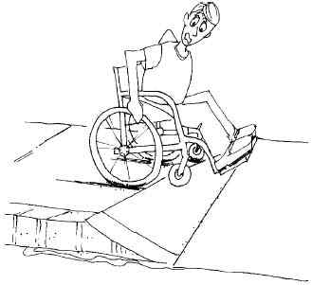
Dominant Culture Views
Strengths
Weaknesses
Attempted ADA laws
Genuinely “trying”
ADA system did not have a genuinely handicapped individual's perspective when designing laws
Perception on sidewalks, gravity differences, and balance capabilities
Notes:
I asked Craig what his views were on the dominant culture and how that has shaped his view thereof. He quickly replied stating that while the dominant culture has made an effort through the American Disability Act (ADA) to help the disabled; he does not believe that someone who truly has experienced disability on a lower scale of living has been consulted while the laws and regulations were set up. He goes further into detail by describing experiences of riding in a wheel chair on the sidewalk of a public street; “The grade on a slope of the sidewalk is scarier than heck in an electric wheelchair.” In asking him to clarify, he mentioned that a person in a wheel chair’s center of gravity is higher up than a person who is walking, so as they come off the slope or dip in the sidewalk, it throws their equilibrium, essentially putting the individual somewhat sideways; something I had certainly never thought about, and potentially something that is unlikely to have been thought out by the ADA’s actual experience. The slopes are set up to try and help accommodate, but according to Craig, he feels that these efforts are mainly designed as a “feel good” effort. Further discussion led us to critiquing public bathrooms; however, for the sake of a somewhat academic presentation, I will just mention that the thought process in public bathroom handicap stalls are certainly not well designed enough for someone who is wheelchair bound.

Slide 4
Effects on Communication
Looked down on
Hostility vs. intelligent inquiries
Impoliteness
Assumed knowledge
Distinct connection with other amputees
Notes:
When I asked Craig about how his disability affected his interactions with others, he had quite a bit to say after he understood the question. He recalled several instances where individuals had become quite haughty with him over his wheelchair status, or on the other hand, make no connection to his missing leg and how it physically affects him. From blatantly crude questioning to impolite inquiries, Craig has experienced a wide variety of questions, thoughtful statements, and even blatant impoliteness regarding his prosthetic leg. One instance in particular is when he was wearing a pair of longer pants that still showed his prosthetic leg. A lady came into his work and inquired with genuine confusion as to “how [he] could feel his foot while missing part of [his] leg.” Another instance was an older lady who came in and asked for pointers on how to have sex with someone in a wheelchair; his response being to not forget to put on the breaks, purely being sarcastic. The most fascinating part of this tale to me was that the old lady actually considered his comment, never knowing the better that he was yanking her chain. Needless to say, Craig has definitely experienced a different level of communication. His perception to communication from other people lies in that he believes that when he is in the wheelchair, he experiences more hostility from people than he does when he does not use it.
Craig mentioned as well that as he experiences so many people that assume they know all there is to know about people who are in wheelchairs, or moreover, that he knows information regarding “wheelchair life.” Of all the encounters of which he experiences, Craig mentioned that he most closely acknowledges and relates to other amputees. He also mentioned that part of that connection may be simply because as he has had years of experience, it is easy for him to recognize someone else with an amputated extremity even when they are attempting to be discreet.

Slide 5
Prejudice and Discrimination
Experiencing Prejudice
Experiencing Discrimination
Social expectations
Applying for work
  Assuming incapability
Job applications and interviews
Work responsibilities and the possible consequences of under performing
Driving requirements
Notes:
When asked if he had experienced prejudice, Craig was non-hesitant to reply with a solid yes. The most prominent example was regarding people’s assumptions of his capabilities while in his wheelchair. Many times, when a customer asks him for something, they immediately follow the question with an offer to assist in getting the item if it’s higher up than they presume Craig is capable of reaching. The most common prejudice he feels he experiences is the assumption that he is incapable of completing tasks asked of him. Further, when applying for work, he oft experiences the assumption that he is incapable of performing necessary job functions upon discovering that he has a prosthetic leg.
Applying for work can be furthered into the realm of discrimination by potential employers realizing that Craig posses a prosthetic leg and interviews which were initially promising and even where he had been given a promise to return, resulted in a lack of follow up from the employer. One incident was an interview which had gone well and upon Craig’s exit, his interviewer asked why he was limping and Craig stated why; what had started as a fantastic interview again resulted in a lack of communication from the employer. The discrimination that is demonstrated here can be furthered by his present job. Craig recently found out that if he were incapable of reaching products for customers or unable to complete all job functions, he would be without a job.
As we continued to explore the discrimination that Craig has experienced, he pointed out something that I have been aware of, but had never perceived as a discriminating action until this conversation. When he renews his drivers license, he is required to have documentation from his primary care provider stating that he is safe and okay to drive. Further, he is not allowed to operate vehicles that involve transporting other human beings as a profession due to one of his disabilities. I was quite shocked to make the connection of discrimination and maintaining a drivers license when it comes to health issues. I had definitely not seen it in this light before.

Slide 6

Perceived Changes
Expectations of Human Services
Offering Helpful Services
Nothing
A place with detailed resources
  Work places that will specifically hire persons with disabilities
Notes:
When I asked Craig what he expected from human service workers, he surprised me with his reply: “Nothing.” He feels that a human service worker should not presume to know anything about someone who is in a wheelchair because everyone is too different in their stories and experiences. If one were to assume that they were informed about a person in a wheelchair, they would likely be wrong to start with.
I then asked what Craig wished was accessible to him through human service workers and he replied with one simple item; a place that had detailed resources of ways to help persons with disabilities. He pointed out that you can go to the Secretary of State office get a detailed list of every business, big or small, internet based or brick and mortar; however, he has yet to figure out a place that has a cumulative list of businesses that are willing to help persons with handicaps. His biggest concern in this matter is that there seems to be no one who is willing to help do any footwork in helping persons with disabilities find work and find sufficient care for their needs.

Slide 7
A New Perception
Disabled individuals are not treated like the ideals that our society assumes
Persons with disabilities are not as compensated as human service workers would like to believe
Change requires action
Notes:
In speaking with Craig, I quickly learned that my bubble-gum view of how persons with disabilities were treated was largely erroneous. Not only did I come to learn that discrimination still does take place, but also that human service workers themselves are even doing a major disservice by not viewing each client uniquely. Additionally, human service workers who are supposed to provide key roles in helpfulness to those who are in need are failing to do so by not being willing to do the necessary footwork needed by these individuals.
After working on this interview, I was surprised to walk away feeling like I had actually learned new information. Prior to my interview with Craig, I felt like I knew and understood how he felt about his disability; however, it became quite apparent during the interview that I didn’t have a clue. In order to get a more firm grasp on what is really happening in the world of disability, perhaps abiding by a suggestion made by Craig would be best; put yourself in a wheelchair and go around the block, or use it for a full day. Seeing the world differently, through the eyes of those who experience it differently may actually be the key to the answer of fairness and helpfulness to those with disabilities.

